Slide 1
Deciding WHERE and WHEN

Slide 2
How to decide WHERE
Activities / amenities
Distance from home
Good for families?
Accessible by transit?
Cost / fees
Quiet
Availability

Slide 3
But you can’t always get what we want!
What campgrounds have availability?
Is the campground YOU want full?
When is a good time to reserve
The campground of your choice?
The campsite of your choice?

Slide 4
Using historic reservation data we can provide visitors
The most popular campgrounds
sites
times
Historic booking trends for specific campgrounds
sites
times
“Pre” pre-trip planning information to visitors outside official booking windows

Slide 5
Using historic reservation data we can provide researchers, policy makers, and land stewards
Origin / destinations – when and where are people coming from?
locals or tourists?
crossing state boundaries?
What equipment are they bringing?
cars, RVs, 5th wheels, canoes/kayaks, other
What activities are they interested in?
trending activities

Slide 6
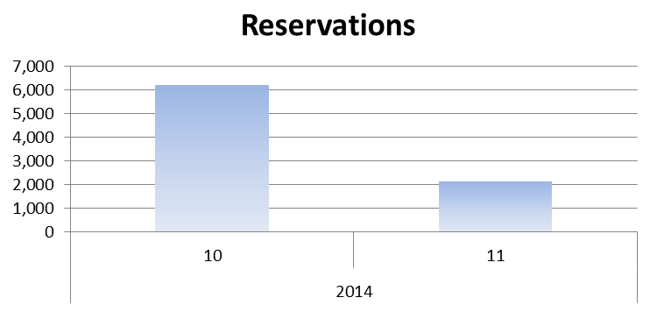
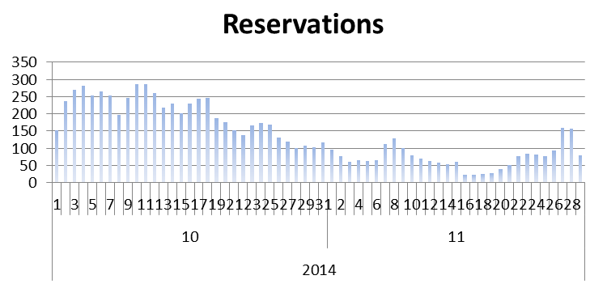
Mather Campground, Nov & Dec 2014

